Slide 1
Maggie Osgood Library
Using the Library Catalog
January 2024
Peggy O’Kane

Slide 2
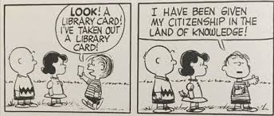
Get a Library card!
Visit the library to sign up for a library card.
We provide cards to anyone who asks.
Please bring identification such as a drivers license with you.
Notes:
Opportunity to sign up after presentation

Slide 3
the Maggie Osgood Library Catalog https://lowell.biblionix.com/catalog

Slide 4
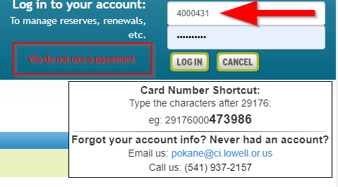
Log in to your account. The login box is in the upper right-hand corner.
Enter the last 6 digits of your library card number.
We do not use passwords.

Slide 5
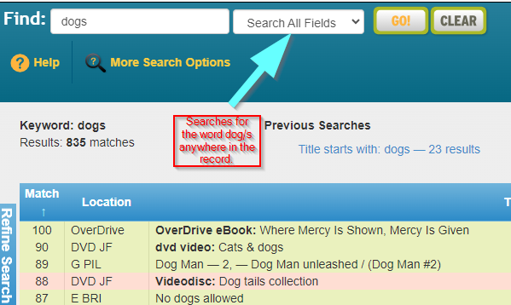
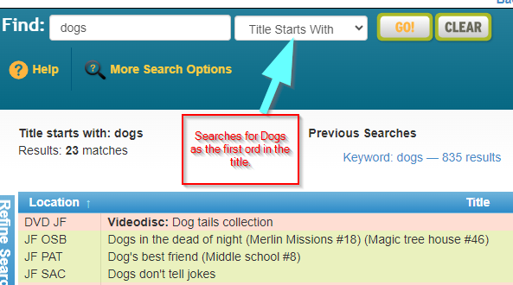
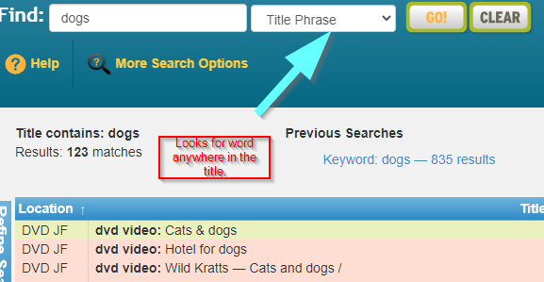
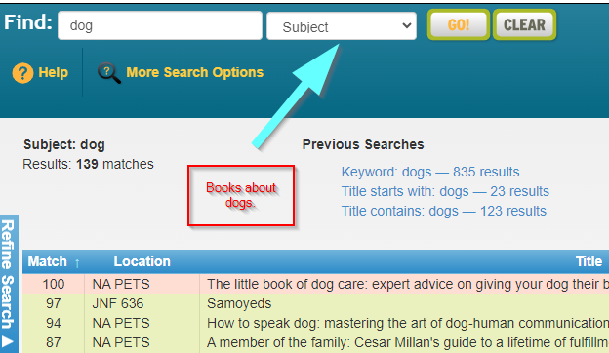
Searching the catalog.
A basic search will look for the word(s) in all the text fields including title, author, subject and notes.
You can limit your search to Title, Author or Subject in the drop-down box.

Slide 6
Advanced Searching
Call # starts with
Medium
Downloadable
Material Type
Reader age
Accelerated Reader
Lexile Measure
Keywords
Title starts with phrase
Title contains phrase
Author
Subject
Reviewed
Language
In Advanced Search you can combine details. This type of searching retrieves fewer items but more accurate ones.

Slide 7
Other search options
If you want to see which Wimpy Kids books are available, choose the series search tab.

Slide 8
Placing a reserve on a book
Items that display in pink are checked out.
Select the reserve button – If you are not logged in the button will not appear!
A box will pop-up asking how you want to be notified. Phone, text or email.
A new notice will give details of the reservation.

Slide 9
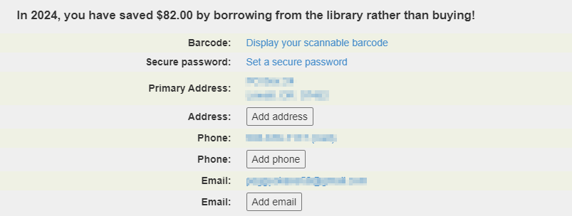
Your Library Account
Opening your library account will let you see what you have currently checked out, renew your books, check and update your contact information and see all the items you have ever checked out.

